Slide 1

DriverPass System Analysis
John Bell
Notes:
[No speaker notes required for this slide.]

Slide 2

System Requirements
Functional
Students will be able to acsess study mateirials and tests
Students will be able to schedule appointments and view packages
Non- functional
Students will have a passwoed to validate them before they log in.
This will be a cloud based web application.
Notes:
The student should have the abillity to acsess to study materials and practice tests.
The student should be able to view appointment times and schedule appointments based on availabillity.
The student should be able to lolg in with a unique case sensitive password that will be validated upon logging in.

Slide 3
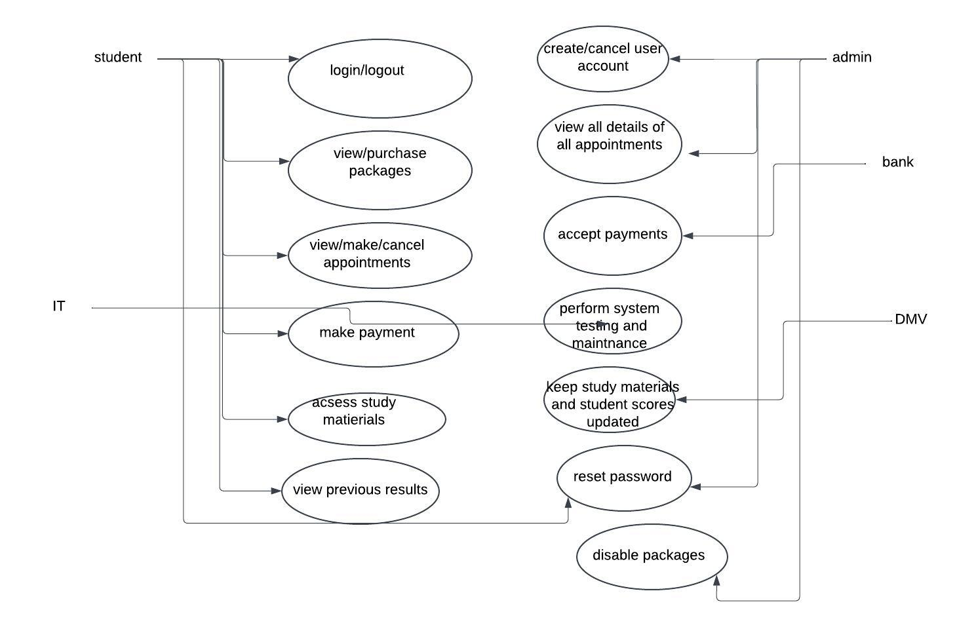
Use Case Diagram
[Insert your use case diagram here.]
Notes:
The users of the system are student, admin, bank and dmv. The student will be able to log in view tests and practice materials, view and select available packages, make a payment and schedule an appointment. The admin will be able to view details about all appointments, start or stop packages, delete user accounts and view all details of the system.the bank will be able to receive and store payments, the dmv will be able to keep study materials and student scores updated.

Slide 4
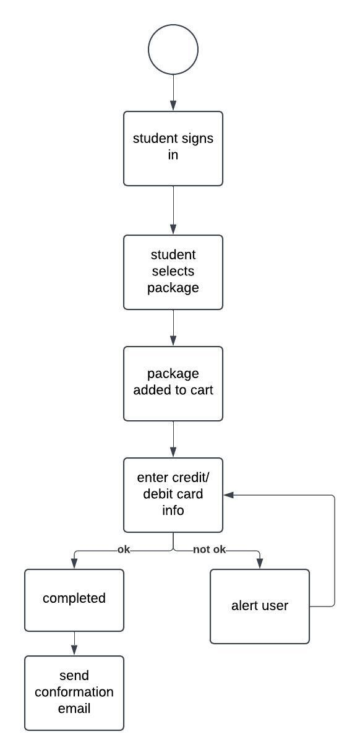
Activity Diagram
Notes:
This is a diagram for purchasing a package. The student logs in, selects a package, the package is added to the cart. The student adds their payment info makse the purchase, if the purchase is sucsessfull the purchase is complete if not the user is alerted about the failed transaction.

Slide 5
Security
User names and passwords are stored in a secure database
Each user will have a uniqe case sensitive password
Accounts will be locked after 5 failed login attempts
Admins can help users reset passwords if needed.
The system will be hosted on a cloud service.
Notes:
Each user will have a unique case sensitive password stored on a cloud for user privacy and security.if the user forgets their password the system admin will bed able to help them reset it. To protect user accounts accounts will be lock after 5 failed login attempts and the user will be alerted of the error.

Slide 6
System Limitations
The system cannot be changed without the help of a developer
System testing may not be available to admin.
Financial transactions will be handled by a bank not the website.
The site may need additional work if its not acsessable on all platforms and mobile devces.
The system may not automatically sync with dmv.
Notes:
The system will require the help of a developer if it needs to to be changed and system testingn may not be able to be tested by admin alone requiring a develper to fix problems. Financial transactions will not be handled by the system but rather by the bank for user privscy and security. The system may need to be updated to work on all devices and plstforms or to be synced with dmv.

